Slide 1
DECODED
An analysis of your favorite song

Slide 2
Agenda for Wednesday 1.14.15
Warm-Up: Quick Write – Talking Photo
*Introduction to Decoded Project
- Computer Lab tomorrow – due 1.22
Tuesdays with Morrie –
due Monday 1.26.15

Slide 3
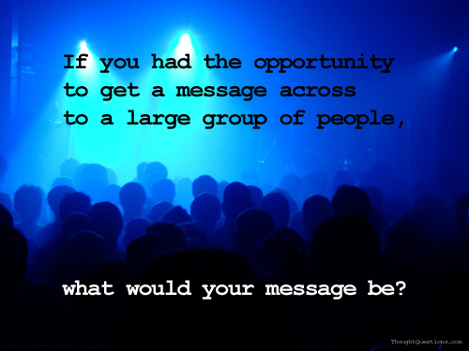

Slide 4
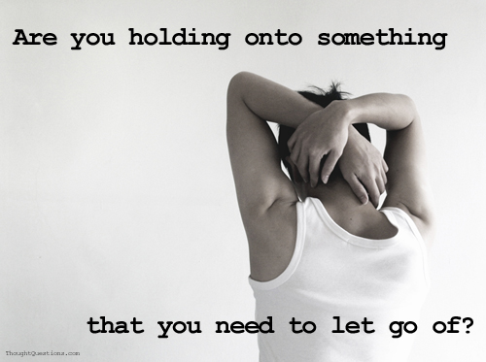

Slide 5
Overview of DECODED
Select your favorite song of ALL TIME!!
You will analyze your favorite song.
You will create a PowerPoint and present your analysis to the class.
You must follow your rubric.

Slide 6
DECODED: Slide 1
Biography of the author of your song:
Slide must include achievements, influences, and other major hits.
Include pictures of your artist/s.
Why did you choose the song? What connection(s) do you have with the song? Make several connections ☺

Slide 7
DECODED: Slide 2
Copy of the song’s lyrics (clean only)
Include video of song.
Lady Gaga "Poker Face"
I wanna hold em' like they do in Texas please Fold em' let em' hit me raise it baby stay with me (I love it) Luck and intuition play the cards with Spades to start And after he's been hooked I'll play the one that's on his heart Oh, oh, oh, oh, ohhhh, oh-oh-e-oh-oh-oh I'll get him hot, show him what I've got Oh, oh, oh, oh, ohhhh, oh-oh-e-oh-oh-oh, I'll get him hot, show him what I've got [Chorus:] Can't read my, Can't read my No he can't read my poker face (she's got to love nobody) Can't read my Can't read my No he can't read my poker face (she's got to love nobody) I wanna roll with him a hard pair we will be A little gambling is fun when you're with me I love it) Russian Roulette is not the same without a gun And baby when it's love if its not rough it isn't fun, fun Oh, oh, oh, oh, ohhhh, oh-oh-e-oh-oh-oh I'll get him hot, show him what I've got Oh, oh, oh, oh, ohhhh, oh-oh-e-oh-oh-oh, I'll get him hot, show him what I've got

Slide 8
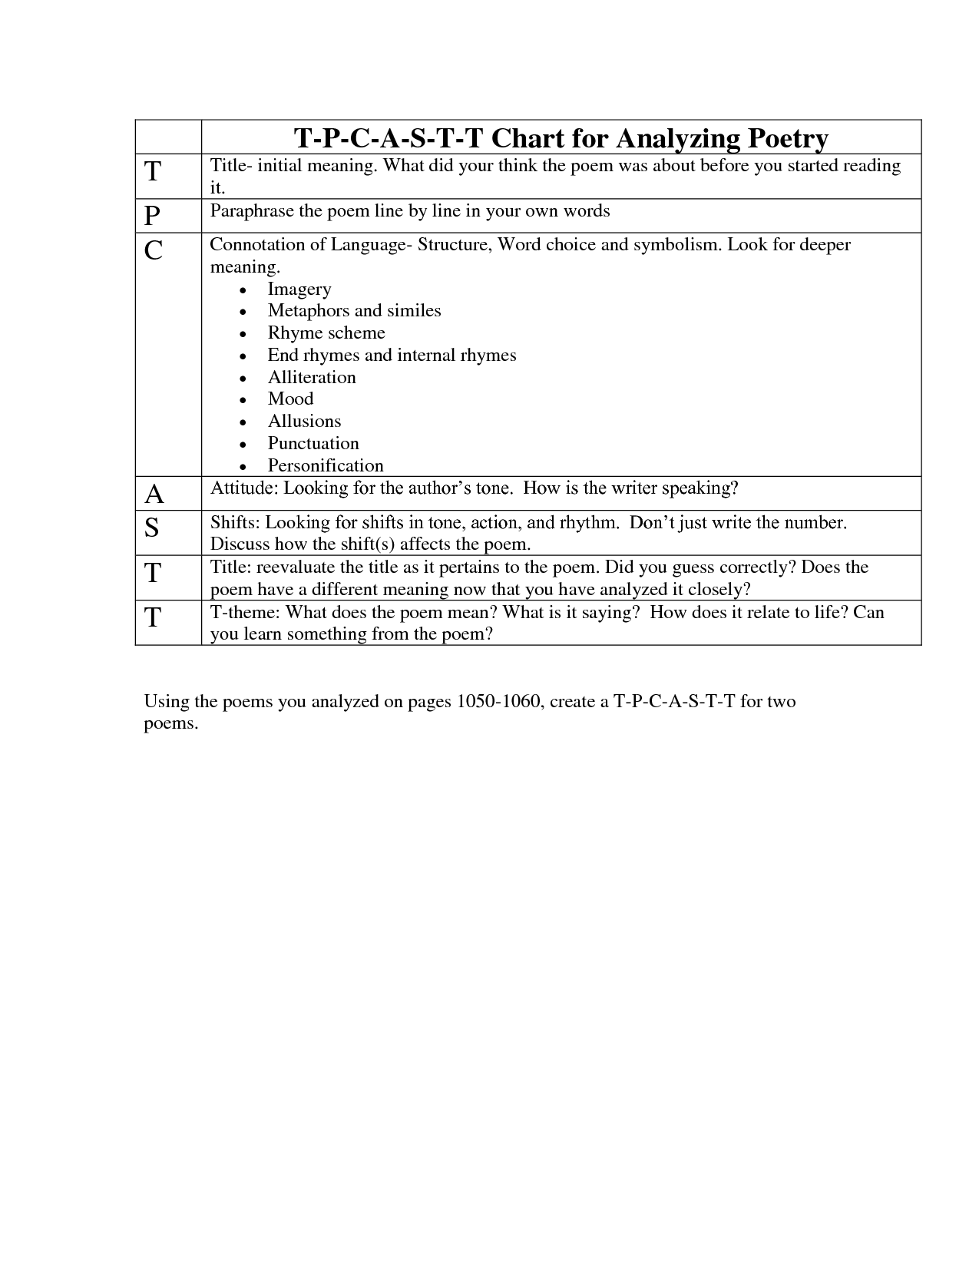
DECODED: Slide 3
Complete a TPCASTT of song.
Information must be included on slide to be presented to class.

Slide 9
DECODED: Slide 4
Read the poem aloud.
Identify the following elements and make notations: rhyme scheme, figurative language images, symbols, sound devices (alliteration, rhythm, onomatopoeia, off rhyme, free verse).
Circle any part of the poem that stands out, confuses them, or is important.
Write questions in the margin.
Highlight unusual words; mark phrases that indicate the poem's meaning.
Determine the poem's theme and draw arrows to the lines that support the theme.
Complete poetry analysis

Slide 10
DECODED: Slide 5
Based on the information compiled from the artist’s biography and analysis, answer the following questions:
How did the artist's life, achievements, etc. affect his or her works?
What possible influences can be seen in his/ her work based in their background?
Each response should be at least 5-7 sentences. Justify your response from specific examples from the texts (biography, analysis, and song)

Slide 11
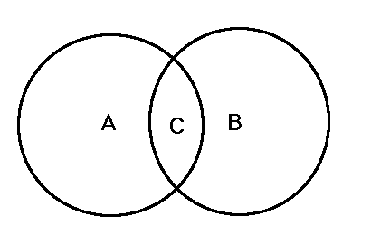
DECODED: Slide 6
Compare and contrast video to lyrics using
graphic organizer

Slide 12
DECODED: Slide 7-9
Include specific examples of figurative language used in song. There should be at least 5 examples of figurative language.
For example:
In Lil’ Wayne’s song “6 Foot, 7”, he states, "I got through that sentence like a subject and a predicate”. This line is an examples of a simile and it is referring to the jail time he served in 2010. The phrase insinuates that he may not have considered jail difficult.

Slide 13
Presentations:
Power Points are due on Thursday January 22, 2015
Be ready to present your finished project to your peers!
☺

