Slide 1
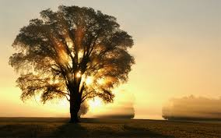
PoeTREE
self discovery-
expressed through poetry

Slide 2
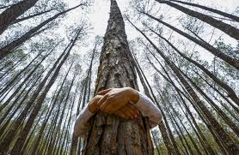
Quick Write
What can a tree symbolize?
When you look at your life, what type of tree would you say represents you/your journey?
Use imagery and explain in detail.
Choose an Overall Topic:
Growth
Values
Life Lessons
Direction for the Future
Morals

Slide 3
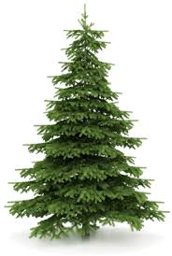
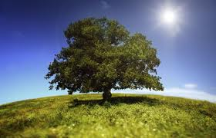
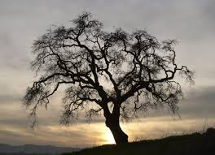
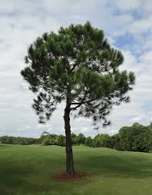
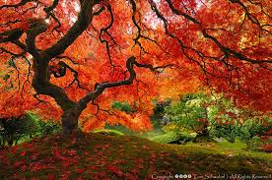
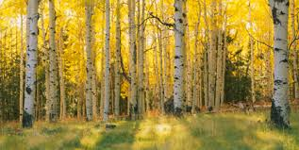
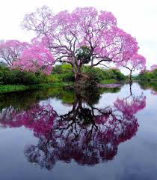
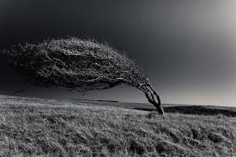
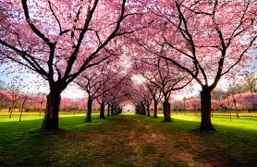
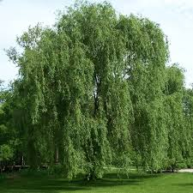
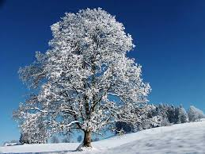
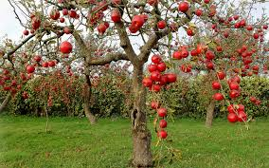
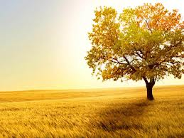
1
2
3
7
5
6
4
1
1
1
1
8
9
10
12
14
13
11

Slide 4
Overview of the Activity:
1. Create a tree – possibly the tree you described in your “Quick Write” to represent you/your life journey so far – be creative, use color, must be in ink.
2. Your tree can be hand drawn, 3D, or can be made on the computer
3. You will be showing who you at this point in your life on your tree by using a quote, symbols, and literary elements/a poem.

Slide 5
Tree Specifics:
Trunk: A quote that represents you/your life at this point
This should correlate with the themes on your tree/your poem
Symbols: Create and place five images on your tree that represent who you are right now.
Explain on the back of your tree what these symbols represent in complete sentences.
Branches: 7-9 branches that include the lines to your poem about the topic of your PoeTREE {possibly about growth, life lessons, morals, trials, strengths, weaknesses, hope, values- whatever you feel is best for you during this period of time} Try to include as many different examples of literary elements as possible:
similes, metaphors, personification, hyperboles, imagery, etc.
YOU: Place yourself somewhere on the piece using a symbol – you can be in the tree, on the ground, in the sky – anywhere.
Explain on the back why you chose this symbol and why you placed it where you did on your project… ☺

